Slide 1





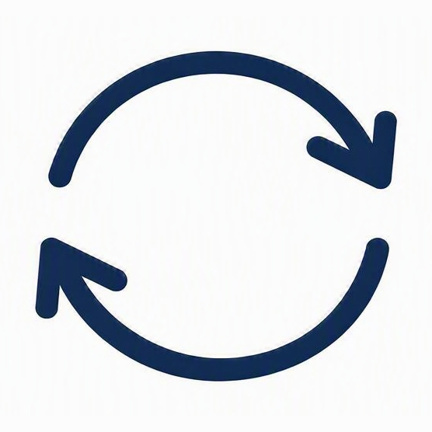


Leadership Learning Journey
PROGRAM AT A GLANCE
A 10-month executive development program — from orientation to capstone
10
Months, end to end
Orientation Session
4
Modules, 3 months apart
START
Program launch · Goals & cohort kickoff
2
Parallel coaching tracks
8
Pre- & post-work assignments
Module 1 · Self-Leadership
PRE-WORK
POST-WORK
Month 1 · Personal effectiveness & EQ
PARALLEL TRACKS
Module 2 · Leading Teams
Run alongside the final 6 months · Months 5–10
PRE-WORK
POST-WORK
Month 4 · Building high-performing teams
Executive Coaching
Module 3 · Strategic Thinking
One-on-one leadership coaching
PRE-WORK
POST-WORK
Month 7 · Vision, strategy & decisions
Module 4 · Leading Change
PRE-WORK
POST-WORK
Business Mentoring
Month 10 · Driving organizational change
Guidance from senior mentors
Capstone Presentation
Both tracks support Modules 3–4 and the capstone project.
FINISH
Final showcase · Present capstone projects

Slide 2
Leadership Learning Journey
PROGRAM AT A GLANCE
A 10-month executive development program — from orientation to capstone
10
Months, end to end
360 Feedback at the beginning of the Leadership journey
Each Module is like an independent workshop with L1 to L3 feedbacks and assignments.
Reflection Journal available to the participants
Participants Leaderboard
Capstone Projects in a group of 5 after the module-1, culminating in a presentation to the Business panel at the end of the Leadership journey
The project group’s regular engagement and co-working
4
Modules, 3 months apart
2
Parallel coaching tracks
8
Pre- & post-work assignments
PARALLEL TRACKS
Run alongside the final 6 months · Months 5–10
Executive Coaching
One-on-one leadership coaching
Business Mentoring
Guidance from senior mentors
Both tracks support Modules 3–4 and the capstone project.

